Slide 1
Pathfinding Session 05
Course : COMP6228 – Artificial Intelligence
Effective Period : February 2018

Slide 2
Learning Objective
After completing this session, students are expected to be able to:
LO 2 : Explain concepts of AI Techniques in Games

Slide 3
Content
The Path-finding Graph
Dijkstra
A*

Slide 4
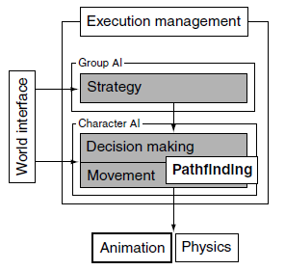
The Pathfinding Graph:
Graphs
In our model of game AI, pathfinding sits on the border between decision making and movement.

Slide 5
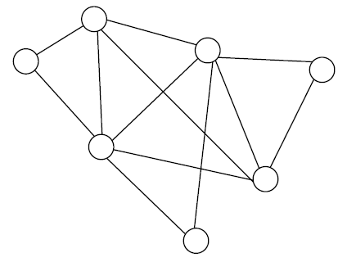
The Pathfinding Graph:
Graphs
A graph is a mathematical structure often represented diagrammatically
A graph consists of two different types of element: nodes are often drawn as points or circles in a graph diagram, while connections link nodes together with lines.

Slide 6
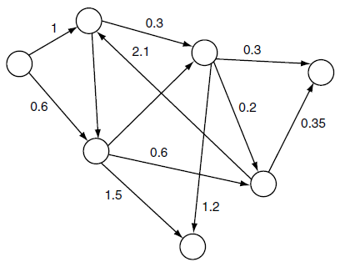
The Pathfinding Graph:
Directed Weighted Graphs
For many situations a weighted graph is sufficient to represent a game level, and we have seen implementations that use this format. We can go one stage further, however.
The major pathfinding algorithms support the use of a more complex form of graph, the directed graph, which is often useful to developers.

Slide 7
The Pathfinding Graph:
Terminology
Terminology for graphs varies. In mathematical texts you often see vertices rather than nodes and edges rather than connections (and, as we’ve already seen, weights rather than costs).
Many AI developers who actively research pathfinding use this terminology from exposure to the mathematical literature. It can be confusing in a game development context because vertices more commonly mean something altogether different.
There is no agreed terminology for pathfinding graphs in games articles and seminars. We have seen locations and even “dots” for nodes, and we have seen arcs, paths, links, and “lines” for connections.

Slide 8
The Pathfinding Graph:
Representation
We need to represent our graph in such a way that pathfinding algorithms such as A* and Dijkstra can work with it.
As we will see, the algorithms need to find out the outgoing connections from any given node.
And for each such connection, they need to have access to its cost and destination.

Slide 9
Dijkstra
The Dijkstra algorithm is named for Edsger Dijkstra, the mathematician who devised it.
Dijkstra’s algorithm wasn’t originally designed for pathfinding as games understand it. It was designed to solve a problem in mathematical graph theory, confusingly called “shortest path.”

Slide 10
Dijkstra
Informally, Dijkstra works by spreading out from the start node along its connections.
As it spreads out to more distant nodes, it keeps a record of the direction it came from (imagine it drawing chalk arrows on the floor to indicate the way back to the start).
Eventually, it will reach the goal node and can follow the arrows back to its start point to generate the complete route.
Because of the way Dijkstra regulates the spreading process, it guarantees that the chalk arrows always point back along the shortest route to the start.

Slide 11
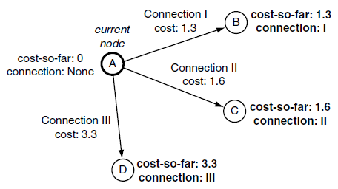
Dijkstra
In the first iteration, where the start node is the current node, the total cost-so-far for each connection’s end node is simply the cost of the connection.
Dijkstra at the first node

Slide 12
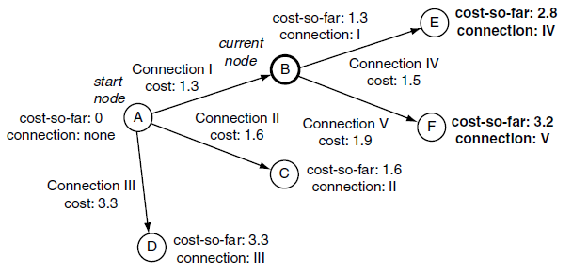
Dijkstra
For iterations after the first, the cost-so-far for the end node of each connection is the sum of the connection cost and the cost-so-far of the current node (i.e., the node from which the connection originated)
Dijkstra with a couple of nodes

Slide 13
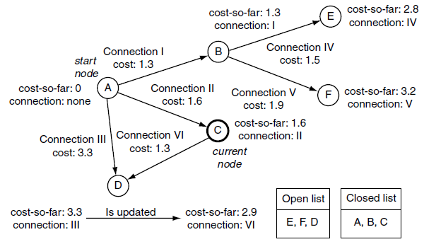
Dijkstra
If we arrive at an open or closed node during an iteration, then the node will already have a cost-so-far value and a record of the connection that led there. Simply setting these values will overwrite the previous work the algorithm has done.
Open node update

Slide 14
Dijkstra
The basic Dijkstra algorithm terminates when the open list is empty: it has considered every node in the graph that be reached from the start node, and they are all on the closed list.
For pathfinding, we are only interested in reaching the goal node, however, so we can stop earlier. The algorithm should terminate when the goal node is the smallest node on the open list.

Slide 15
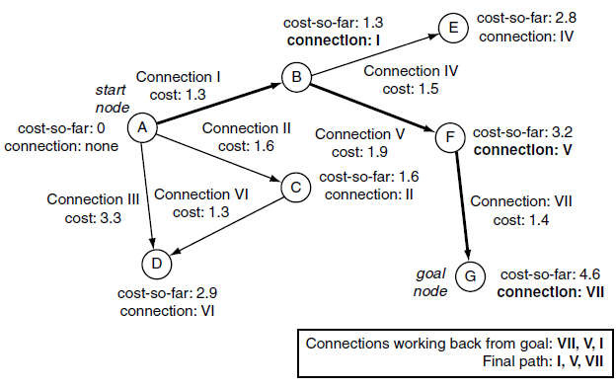
Dijkstra
The final stage is to retrieve the path.
We do this by starting at the goal node and looking at the connection that was used to arrive there. We then go back and look at the start node of that connection and do the same. We continue this process, keeping track of the connections, until the original start node is reached.
Following the connections to get a plan

Slide 16
A*
Pathfinding in games is synonymous with the A* algorithm.
A* is simple to implement, is very efficient, and has lots of scope for optimization.
Every pathfinding system we’ve come across in the last 10 years has used some variation of A* as its key algorithm, and it has applications well beyond pathfinding too
Unlike the Dijkstra algorithm, A* is designed for point-to-point pathfinding and is not used to solve the shortest path problem in graph theory

Slide 17
A*
During an iteration, A* considers each outgoing connection from the current node.
For each connection it finds the end node and stores the total cost of the path so far (the “cost-so-far”) and the connection it arrived there from, just as before.
It also stores one more value: the estimate of the total cost for a path from the start node through this node and onto the goal (we’ll call this value the estimated-total-cost).
This estimate is the sum of two values: the cost-so-far and how far it is from the node to the goal.
This estimate is generated by a separate piece of code and isn’t part of the algorithm.

Slide 18
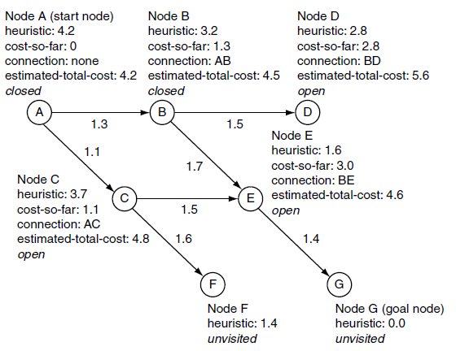
A*
These estimates are called the “heuristic value” of the node, and it cannot be negative (since the costs in the graph are non-negative, it doesn’t make sense to have a negative estimate).
A* estimated-total-costs

Slide 19
A*
We calculate the cost-so-far value as normal, and if the new value is lower than the existing value for the node, then we will need to update it.
Unlike Dijkstra, the A* algorithm can find better routes to nodes that are already on the closed list.
Fortunately, there is a simple way to force the algorithm to recalculate and propagate the new value. We can remove the node from the closed list and place it back on the open list. It will then wait until it is closed and have its connections reconsidered. Any nodes that rely on its value will also eventually be processed once more.

Slide 20
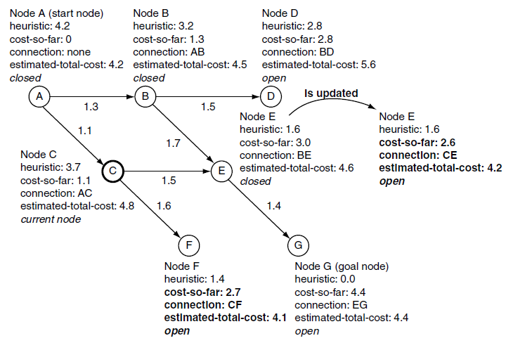
A*
Closed node update

Slide 21
References
Ian Millington. 2009. Artificial intelligence for games. Morgan Kaufmann Publishers. Burlington. ISBN:9780123747310
Introduction to A*, http://theory.stanford.edu/~amitp/GameProgramming/AStarComparison.html

